Slide 1

Rockbuster Stealth Data Dictionary
By: Malachi Simmons

Slide 2
Table of Contents
Slide 3: Entity Relationship Diagram (ERD)
Slide 4: Legend
Fact Tables:
Slide 5: Rental
Slide 6: Payment
Slide 18: Language
Slide 19: Category
Slide 16: Actor
Slide 17: Film
Slide 7: Film Category
Slide 8: Store
Slide 14: Film Actor
Slide 15: Inventory
Dimension Tables:
Slide 9: Customer
Slide 10: Staff
Slide 11: Address
Slide 12: City
Slide 13: Country

Slide 3
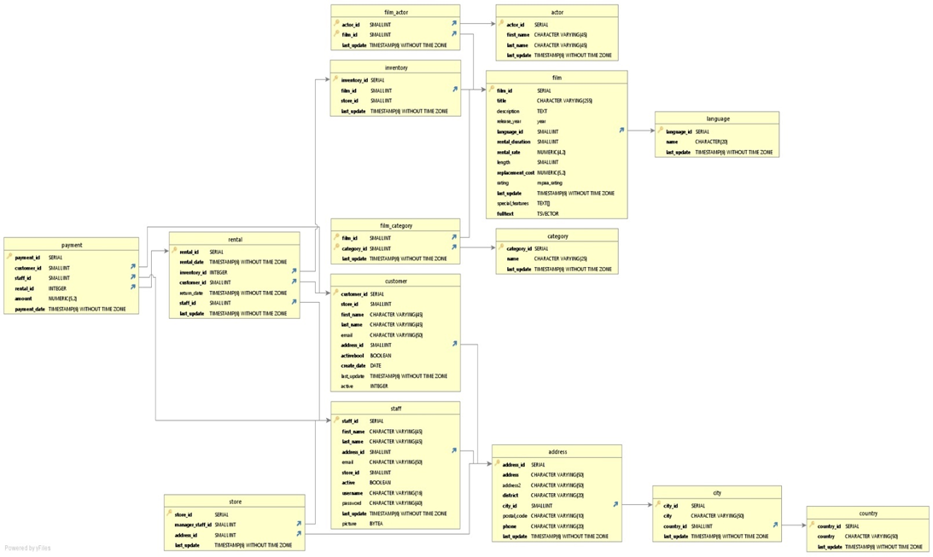
ERD

Slide 4
Legend

Slide 5
Fact Table: Rental

Slide 6
Fact Table: Payment

Slide 7
Fact Table: Film Category

Slide 8
Fact Table: Store

Slide 9
Dimension Table: Customer

Slide 10
Dimension Table: Staff

Slide 11
Dimension Table: Address

Slide 12
Dimension Table: City

Slide 13
Dimension Table: Country

Slide 14
Dimension Table: Film Actor

Slide 15
Dimension Table: Inventory

Slide 16
Dimension Table: Actor

Slide 17
Dimension Table: Film

Slide 18
Dimension Table: Language

Slide 19
Dimension Table: Category

